Slide 1
Chapter 9 - Scheduling
I want a turn. Now!

Slide 2
Topics to Cover…
Topics
Scheduling
Priorities
Preemption
Response Time
Algorithms

Slide 3
CPU Scheduling
Scheduling
Fundamentally, scheduling is a matter of managing queues to minimize queuing delay and to optimize performance in a queuing environment.
Scheduling needs to meet system objectives, such as:
minimize response time
maximize throughput
maximize processor efficiency
support multiprogramming
Scheduling is central to OS design

Slide 4
Switching is Expensive
Scheduling
Process A
Process A
Switch to Kernel
Kernel
Switch to User
Pick a process
Process B
Process B
Reset MMU
Store Process State
Load Process State
Memory

Slide 5
Overhead
Scheduling
Processes are dependent
on I/O
dependency level varies
Process cycle
compute
wait for I/O
Process execution is characterized by
length of CPU burst
number of bursts
160
140
120
100
80
60
40
20
Most processes have a
large number of short
CPU bursts
Frequency
0 8 16
Burst Duration (milliseconds)
Direct Cost: time to actually switch
Indirect Cost: performance hit from memory (dirty cache, swapped out pages, etc.)

Slide 6
When to Schedule?
Scheduling
Compute-bound
I/O-bound
Process creation
Process exit
Process blocks
I/O Interrupt
Non-preemptive: wait until exit or block
Preemptive: interrupt if necessary

Slide 7
Different Needs
Scheduling
Batch: no terminal users
payroll, inventory, interest calculation, etc.
Interactive: lots-of-I/O from users
Real-time: process must run and complete on time
Typically real-time only runs processes specific to the application at hand
General Purpose (clueless)

Slide 8
Type of Scheduling
Scheduling
Long-term
performed when new process is created
the more processes created, the smaller the percentage of time for each process
keep a mix of processor-bound and I/O-bound
Medium-term
swapping to maintain a degree of multiprogramming
memory management an issue (virtual memory)
Short-term
which ready process to execute next – dispatcher
due to clock interrupts, I/O interrupts, system calls, signals

Slide 9
Queuing Diagram for Scheduling
Scheduling
Long-term
scheduling
Time-out
Batch
jobs
Ready Queue
Short-term
scheduling
Release
Processor
Medium-term
scheduling
Interactive
users
Ready, Suspend Queue
Medium-term
scheduling
Blocked, Suspend Queue
Blocked Queue
Event Wait
Event
Occurs
Notes:
9

Slide 10
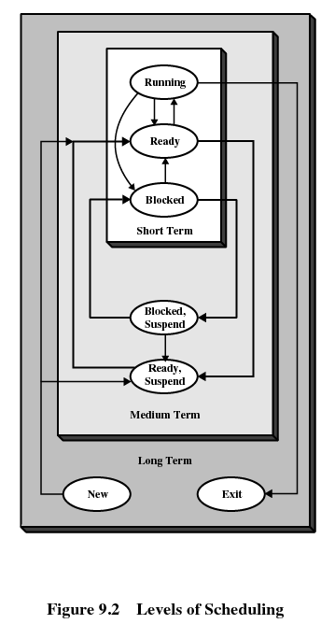
Goals
Scheduling
All Systems
Fairness
Policy Enforcement
Balance
Batch Systems
Throughput
Turnaround time
CPU utilization
Interactive Systems
Response time
Proportionality
Real-time Systems
Meeting deadlines
Predictability
Notes:
Policy enforcement: consider a nuclear power plant, the policy says safety control runs anytime it wants. Then the schedule enforces this policy even though it means payroll may be late.
10

Slide 11
Scheduling Criteria
Scheduling Criteria
Throughput
Number of jobs processed per unit of time
Turnaround time
Time from submission to completion (batch jobs)
Response time
Time to start responding (interactive users)
Deadlines
Maximize number of deadlines met
Processor utilization
Percent of time CPU is busy

Slide 12
Scheduling Criteria
Scheduling Criteria
Proportionality
Things meet expectations (things that take time take time and things that do not take time do not take time)
Predictability
Same time/cost regardless of load on the system
Fairness
No process should suffer starvation
Enforcing priorities (or policy)
Favor higher priority processes
Balancing resources
Keep system resources busy

Slide 13
Preemptive vs. Non-preemptive
Preemption
Scheduling that only takes place due to I/O or process termination is non-preemptive.
Preemptive scheduling allows the operating system to interrupt the currently running process and move it to the ready state.
new process arrives
clock interrupt
Preemptive scheduling:
incurs greater overhead (context switch)
provides better service to the total population of processes
may prevent one process from monopolizing the processor

Slide 14
Response Time
Response Time
User productivity tends to improve with a more rapid response time.
Especially true for expert users
Becomes very noticeable as response time drops below 1 second
User time or “think time” – Time user spends thinking about the response.
System time – Time system takes to generate its response.
Short response times are important
User response time tends to decrease as system response time decreases
If the system gets too slow to a user, they may slow down or abort the operation
Turnaround time (TAT) – total time that an item spends in the system.

Slide 15
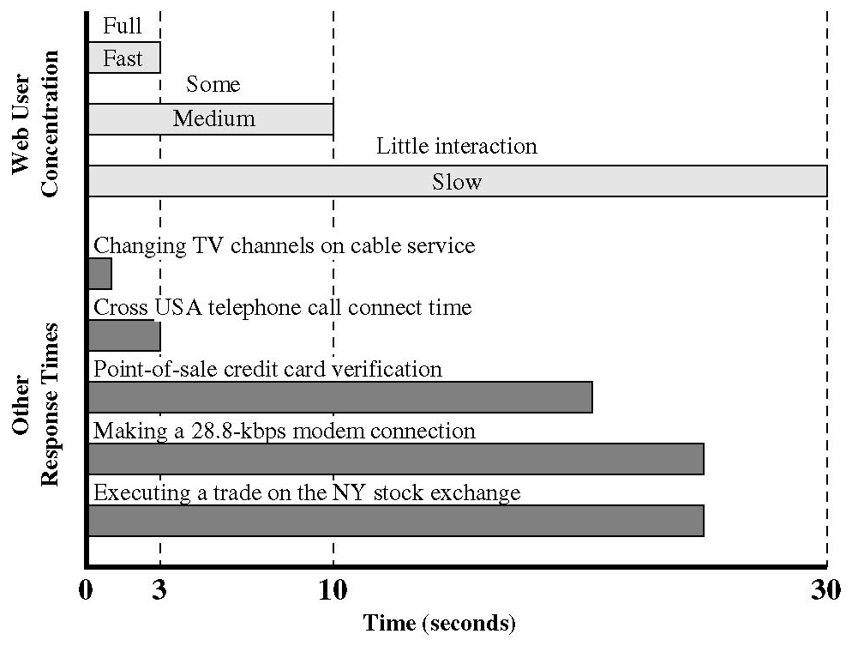
Response Time (continued…)
Response Time
Web Pages – Loading a page in 3 seconds or less increases the user’s attention
User may abort after 10s or more
Must balance response time with the cost required
Faster/more expensive hardware may be required
Priorities that may penalize certain processes

Slide 16
Response Times (continued…)
Response Time
15 seconds or greater
•Rules out conversational interaction.
•Most users will not wait this long.
•If it cannot be avoided, allow the user to continue on to something else (like foreground/background threads).
4 to 15 seconds
•Generally user loses track of the current operation in short-term memory
•Ok after end of a major closure
2 to 4 seconds
•Inhibits user concentration
•Bothers a user who is focused on the job
•Ok after end of a minor closure
1 to 2 seconds
•Important when information has to be remembered over several responses
•Important limit for terminal activities
Less than 1 second
•For keeping user’s attention for thought-intensive activities
•Example: graphics
Less than 1/10 second
•Response to key presses or mouse clicks

Slide 17
Scheduling
Scheduling
Priorities
Are some processes more important than others?
Don’t want to starve low-priority processes
Decision Mode
Will we suspend the currently active process if it can continue?
No: Nonpreemptive
Yes: Preemptive
Some systems (Win 3.1, early Mac) used cooperative multitasking (processes voluntarily give up the CPU)
Preemption incurs more O.S. overhead, but prevents monopolizing the processor
Also helps with infinite loops

Slide 18
Scheduling Algorithms
Algorithms
First Come First Served (FCFS)
Round Robin (RR) – time slicing.
Shortest Process Next (SPN)
Shortest Remaining Time (SRT)
Highest Response Ratio Next (HRRN)
Feedback

Slide 19
First-Come-First-Served (FCFS)
Algorithms
Process | Arrival | Service
1 | 0 | 3
2 | 2 | 6
3 | 4 | 4
4 | 6 | 5
5 | 8 | 2
0
5
10
15
20
1
2
3
4
5

Slide 20
FCFS (continued…)
Algorithms
First-Come-First-Served - each process joins the Ready queue
When the current process ceases to execute, the oldest process in the Ready queue is selected
A short process may have to wait a very long time before it can execute.
Favors CPU-bound processes over I/O-bound processes.
I/O processes have to wait until CPU-bound process completes
FCFS, although not attractive alternative for a uni-processor system, when combined with a priority scheme may prove to be an effective scheduler.

Slide 21
Round-Robin (RR)
Algorithms
Process | Arrival | Service
1 | 0 | 3
2 | 2 | 6
3 | 4 | 4
4 | 6 | 5
5 | 8 | 2
0
5
10
15
20
1
2
3
4
5

Slide 22
Round Robin (continued…)
Algorithms
Uses FCFS w/preemption - based on a clock (time slicing).
Short time quantum: processes move relatively quickly through the system (with more overhead).
The time quantum should be slightly greater than the time required for a typical interaction.
Particularly effective in GP time-sharing or transaction processing system.
Generally favors processor bound processes as I/O bound give up their time slice while process bound use their complete time quantum.
Could be improved using a virtual round robin (VRR) scheduling scheme – implement an auxiliary I/O queue which gets preference over the main queue.

Slide 23
Shortest Process Next (SPN)
Algorithms
Process | Arrival | Service
1 | 0 | 3
2 | 2 | 6
3 | 4 | 4
4 | 6 | 5
5 | 8 | 2
0
5
10
15
20
1
2
3
4
5

Slide 24
Shortest Process Next
Algorithms
Shortest Process Next - Non-preemptive policy
Process with shortest expected processing time is selected next
Short process jumps ahead of longer processes
May be impossible to know or at least estimate the required processing time of a process.
For batch jobs, require a programmer’s estimate.
If estimate is substantially off, system may abort job.
In a production environment, the same jobs run frequently and statistics may be gathered.
In an interactive environment, the operating system may keep a running average of each “burst” for each process.
SPN could result in starvation of longer processes if there is a steady supply of short processes.
Not suitable for time-sharing or transaction processing environment because of lack of preemption.

Slide 25
Shortest Remaining Time (SRT)
Algorithms
Process | Arrival | Service
1 | 0 | 3
2 | 2 | 6
3 | 4 | 4
4 | 6 | 5
5 | 8 | 2
0
5
10
15
20
1
2
3
4
5

Slide 26
Shortest Remaining Time
Algorithms
The shortest remaining time (SRT) policy is a preemptive version of SPN.
Must estimate expected remaining processing time
When a new process joins the ready queue, it may have a shorter remaining time and preempts the current process.
SRT does not bias in favor of long processes (as does FCFS)
Unlike RR, no additional interrupts are generated reducing overhead.
Superior turnaround performance to SPN, because a short job is given immediate preference to a running longer job.

Slide 27
Highest Response Ratio Next (HRRN)
Algorithms
time spent waiting + expected service time
expected service time
Process | Arrival | Service
1 | 0 | 3
2 | 2 | 6
3 | 4 | 4
4 | 6 | 5
5 | 8 | 2
0
5
10
15
20
1
2
3
4
5

Slide 28
Highest Response Ration Next
Algorithms
Choose next process with the highest ratio
Attractive approach to scheduling because it accounts for the age of a process.
While shorter jobs are favored (a smaller denominator yields a larger ratio), aging without service increases the ratio so that a longer process will eventually get past competing shorter jobs.

Slide 29
Feedback
Algorithms
If we have no indication of the relative length of various processes, then SPN, SRT, and HRRN cannot be effectively used.
ie. if we cannot focus on time remaining, focus on time spent in execution so far.
Using feedback, we can give preference for shorter jobs by penalizing jobs that have been running longer.
Feedback scheduling is done on a preemptive basis with a dynamic priority mechanism.
A process is demoted to the next lower-priority queue each time it returns to the ready queue.

Slide 30
Feedback (continued…)
Algorithms
Within each queue, a simple FCFS mechanism is used except once in the lowest-priority queue, a process cannot go lower and is treated in a RR fashion.
Longer processes gradually drift downward.
Newer, shorter processes are favored over older, longer processes.
Feedback scheduling can make turnaround time for longer processes intolerable.
To avoid starvation, preemption time for lower-priority processes is usually longer.

Slide 31
Comparisons
Comparisons
Selection Function
Decision Mode
Throughput
Response Time
Overhead
Effect on Processes
Starvation
FCFS
max[w]
Non-preemptive
Not emphasized
May be high, especially if there is a large variance in process execution times
Minimum
Penalizes short processes; penalizes I/O bound processes
NO
Round Robin (RR)
constant
Preemptive (at time quantum)
May be low if quantum is too small
Provides good response time for short processes
Minimum
Fair treatment; although it penalizes I/O bound processes
NO
Shortest Process Next (SPN)
min[t]
Non-preemptive
High
Provides good response time for short processes
Can be high
Penalizes long processes
Possible
Shortest Remaining Time (SRT)
min[s – e]
Preemptive (at arrival)
High
Provides good response time
Can be high
Penalizes long processes
Possible
Highest Response Ratio Next (HRRN)
max((w + t) / t)
Non-preemptive
High
Provides good response time
Can be high
Good balance
NO
Feedback
Adjustable
Preemptive (at time quantum)
Not emphasized
Not emphasized
Can be high
May favor I/O bound processes
Possible

Slide 32
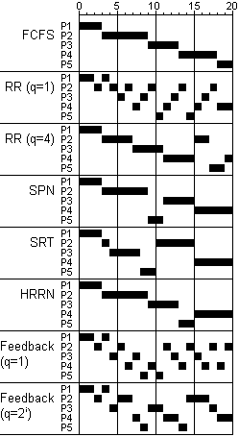
Comparisons
Comparisons
P1
P2
P3
P4
P5
Mean
Arrival
0
2
4
6
8
Service Time
3
6
4
5
2
FCFS
Finish
3
9
13
18
20
P1: arrives at time 0, requires 3 units
P2: arrives at time 2, requires 6 units
P3: arrives at time 4, requires 4 units
P4: arrives at time 6, requires 5 units
P5: arrives at time 8, requires 2 units
Turnaround
3
7
9
12
12
8.60
Tr / Ts
1.00
1.17
2.25
2.40
6.00
2.56
RR (q=1)
Finish
4
18
17
20
15
Turnaround
4
16
13
14
7
10.80
Tr / Ts
1.33
2.67
3.25
2.80
3.50
2.71
RR (q=4)
Finish
3
17
11
20
19
Turnaround
3
15
7
14
11
10.00
Tr / Ts
1.00
2.50
1.75
2.80
5.50
2.71
SPN
Finish
3
9
15
20
11
Turnaround
3
7
11
14
3
7.60
Tr / Ts
1.00
1.17
2.75
2.80
1.50
1.84
SRT
Finish
3
15
8
20
10
Turnaround
3
13
4
14
2
7.20
Tr / Ts
1.00
2.17
1.00
2.80
1.00
1.59
HRRN
Finish
3
9
13
20
15
Turnaround
3
7
9
14
7
8.00
Tr / Ts
1.00
1.17
2.25
2.80
3.50
2.14
Feedback (q=1)
Finish
4
20
16
19
11
Turnaround
4
18
12
13
3
10.00
Tr / Ts
1.33
3.00
3.00
2.60
1.50
2.29
Feedback ( q=2^(i-1) )
Finish
4
17
18
20
14
Turnaround
4
15
14
14
6
10.60
Tr / Ts
1.33
2.50
3.50
2.80
3.00
2.63

Slide 33
Guaranteed Scheduling
Guaranteed Scheduling
If n users then you get 1/n of CPU
Or if n processes then you get 1/n of CPU
Track creation time
Track time actually used
Compute time since creation divided by n --- this is the time you are entitled too
CPU Consumed / CPU entitled
0.5 → only half of what it should have had
2.0 → Twice more than entitled
Choose process with least ratio
Notes:
33

Slide 34
Guaranteed Scheduling
Guaranteed Scheduling
Current time is 13
P₀
P₂
P₃
P₄
T_{c} = 0
T_{u} = 4
T_{c} = 2
T_{u} = 1
T_{c} = 2
T_{u} = 2
T_{c} = 4
T_{u} = 6
T_{e} = 13 / 4
= 3.25
T_{e} = 11 / 4
= 2.75
T_{e} = 11 / 4
= 2.75
T_{e} = 9 / 4
= 2.25
P = 4 / 3.25
= 1.23
P = 1 / 2.75
= 0.36
P = 2 / 2.75
= 0.72
T_{e} = 6 / 2.25
= 2.66
Notes:
Tc is the time of creation
Tu is the time used on CPU thus far
Te is the time it is entitled too use (determined when scheduled based on priority and past behavior—finishing before or after time slice) computed by dividing the time the process has been active by the total number of processes
P is the priority: ratio of time consumed over entitled time
Highest priority wins
34

Slide 35
Lottery Scheduling
Lottery Scheduling
Issue tickets to process
Choose random ticket as the next job
If you have the ticket, then its you
Assign number of tickets by priority
If 100 tickets, if process has 20 tickets, then 20% chance it wins the lottery
Can exchange tickets
Can award tickets to priority boost

Slide 36
Lottery Scheduling
Lottery Scheduling
Issue 100 Lottery Tickets
P₀
30%
P₂
15%
P₃
25%
P₄
30%
T = 30
T = 15
T = 25
T = 30
Ticket holder gets CPU until next drawing
Notes:
Showing priorities with each process.
Allocated tickets according to priority
36

Slide 37
Fair Scheduling
Fair Scheduling
User’s application runs as a collection of processes (threads)
Unfair to make scheduling decisions solely based on individual processes/threads
More fair to allocate time according to groups
First allocate time fairly to group
then divide the time between processes owned by the group
Repeat recursively
User 1: ABCD, User 2: E. To be fair, each gets ½
Standard RR: ABCDEABCDE…
Each user has fair share: AEBECEDE…
But if user 1 entitled to twice as much…
Fair Scheduling: ABECDEABECDE…
Notes:
37

Slide 38
Linux 2.6.21 Completely Fair Scheduler (CFS)
Fair Scheduling
27
19
34
7
25
31
65
2
49
98
Notes:
http://www.ibm.com/developerworks/linux/library/l-completely-fair-scheduler/
Con Kolivas was pitching a rotating staircase deadline scheduler (RSDL) that incorporated fairness with a bound—goal is maximize CPU usage while retaining interactive responsiveness. Ingo Molnar who wrote the O(1) took ideas from Con Kolivas and put together in 62 hours of program a 100k line patch that is the CFS scheduler (came with no small amount of controversy too as Con’s scheduler was discussed as being mainlined in 2.6.21 when Ingo released the CFS which was quickly adopted and mainlined over RSDL).
The goal is to balance fairness in providing processor time to tasks. A process should be given a fair amount of process time. The CFS maintains the amount of time provided to a given task in what is called the virtual runtime. The smaller a task’s virtual runtime—the smaller amount of time a task has been permitted on the processor—the higher its need for the processor. The CFS also includes the concept of sleeper fairness to ensure that tasks that are not currently runnable (waiting for I/O) receive a comparable share of the processor when they eventually need it.
Tasks are not in a run queue anymore. They are in a red-black tree (balance binary tree). The tree is queue on virtual runtime. The task with the least virtual runtime (gravest need) is in the left most branch. The task with the least need is in the right most branch. The scheduler, to be fair, picks the left most node of the tree to schedule next. The task accounts for its time with the CPU by adding its execution time to the virtual runtime and is then inserted back into the tree if runnable. In this way, tasks on the left side of the tree are given time to execute, and the contents of the tree migrate from the right to the left to maintain fairness.
The pre-emption is set dynamically depending on the task priority. Priorities still dynamically adjust. And the rates of virtual runtime are scaled according to priority as well (i.e., time passes at different rates for each task to account for priority in the “fairness”).
CFS in 2.6.24 includes the ability to group schedule.
Other improvements include the modularity of the scheduler.
38

Slide 39
Conclusion
Scheduling critical to performance
Must be tuned to work-load and system
Real desktop schedulers use same ideas
Much more complex to account for the varying workload of several applications
Must bet both responsive and serve CPU-bound processes as well
More to come…

